Slide 1
Lecture 3
Recurrence Relations and how to solve them!

Slide 2
Announcements!
Sections and office hours have been scheduled!
See course website for details.
HW1 is posted!
Due Friday.
Follow the Piazza post on HW1 for updates.
(STILL) sign up for Piazza!
There’s a link on the course website.
Course announcements will be posted on Piazza.
OAE requests and exam conflicts:
cs161-win1819-staff@lists.stanford.edu
Please send requests by Jan. 21 (one week from today)

Slide 3
Last time….
Sorting: InsertionSort and MergeSort
Analyzing correctness of iterative + recursive algs
Via “loop invariant” and induction
Analyzing running time of recursive algorithms
By writing out a tree and adding up all the work done.
How do we measure the runtime of an algorithm?
Worst-Case Analysis
Big-Oh Notation

Slide 4
Quick clarification about proving things about O() notation

Slide 5
Example $$2n^{2}+10=O\left(n^{2}\right)$$
$$T\left(n\right)=O\left(g\left(n\right)\right)$$
$$⟺$$
$$∃c, n_{0}>0 s.t. ∀n≥n_{0},$$
$$0≤T\left(n\right)≤c⋅g(n)$$
SLIDE FROM LAST TIME
n₀=4
Formally:
Choose c = 3
Choose n₀ = 4
Then:
3g(n) = 3n²
T(n) = 2n² + 10
$$∀n≥4,$$
$$0≤2n^{2}+10≤3⋅n^{2}$$
g(n) = n²

Slide 6
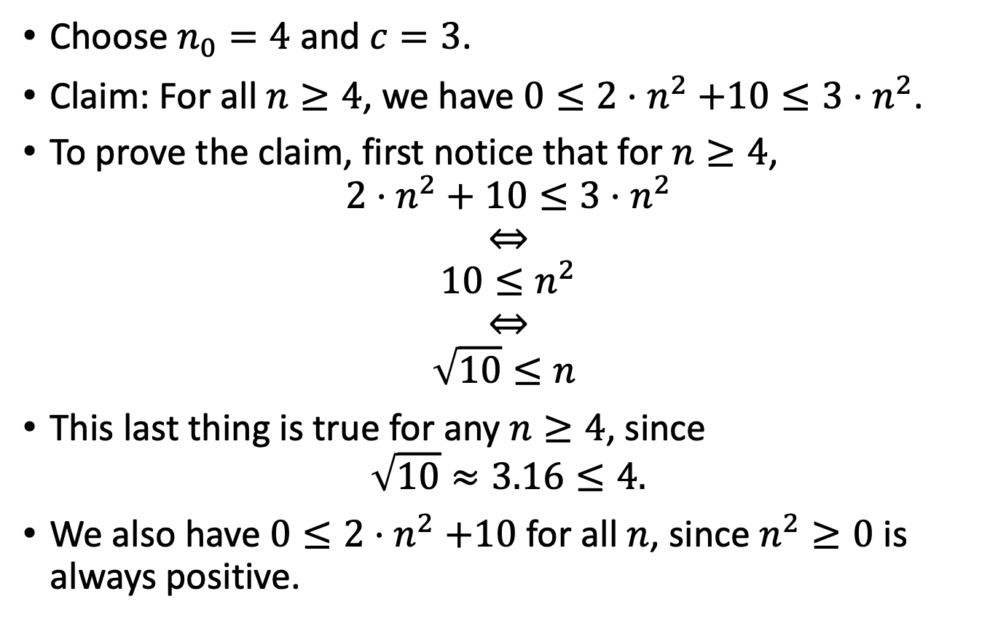
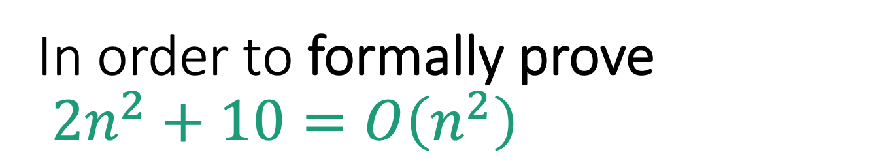
In order to formally prove $2n^{2}+10=O\left(n^{2}\right)$
Choose $n_{0}=4$ and $c=3$.
Claim: For all $n≥4$, we have $0≤2{⋅n}^{2}+10≤3⋅n^{2}$.
To prove the claim, first notice that for $n≥4$,
$$2⋅n^{2}+10≤3⋅n^{2}$$
$$⇔$$
$$10≤n^{2}$$
$$⇔$$
$$\sqrt{10}≤n^{ }$$
This last thing is true for any $n≥4$, since
$$\sqrt{10}≈3.16≤4.$$
We also have $0≤2{⋅n}^{2}+10$ for all $n$, since $n^{2}≥0$ is always positive.
This is sufficient rigor for your homework!

Slide 7
Today
Recurrence Relations!
How do we calculate the runtime a recursive algorithm?
The Master Method
A useful theorem so we don’t have to answer this question from scratch each time.
The Substitution Method
A different way to solve recurrence relations, more general than the Master Method.

Slide 8
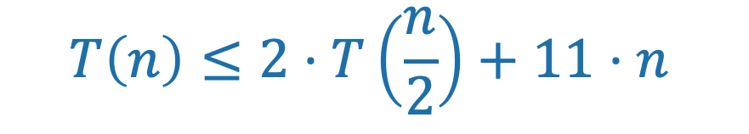
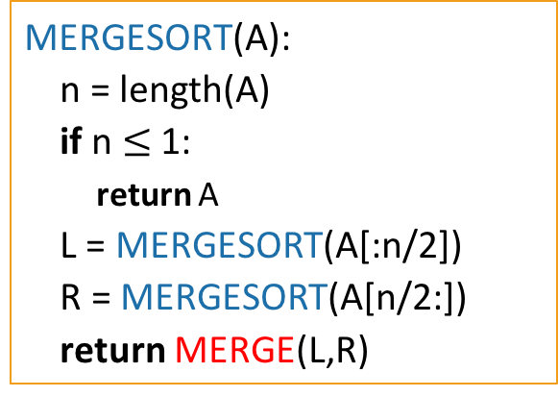
Running time of MergeSort
Let’s call this running time T(n).
when the input has length n.
We know that T(n) = O(nlog(n)).
We also know that T(n) satisfies:
MERGESORT(A):
n = length(A)
if n $≤$ 1:
return A
L = MERGESORT(A[:n/2])
R = MERGESORT(A[n/2:])
return MERGE(L,R)
$$T\left(n\right)≤2⋅T\left(\frac{n}{2}\right)+11⋅n$$
Last time we showed that the time to run MERGE on a problem of size n is at most 11n operations.

Slide 9
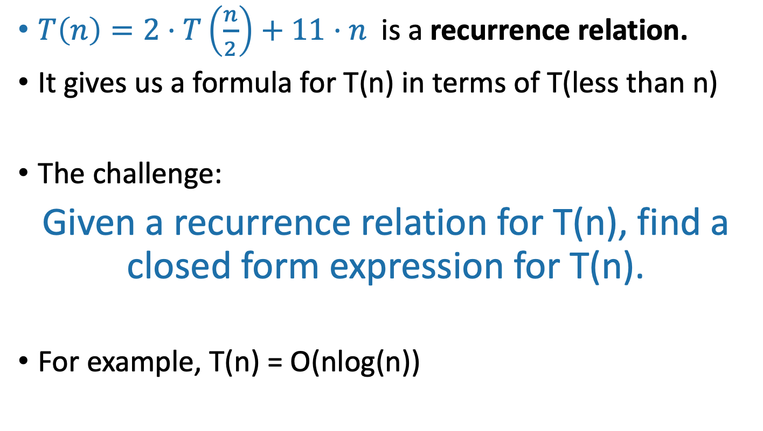
Recurrence Relations
$T\left(n\right)=2⋅T\left(\frac{n}{2}\right)+11⋅n$ is a recurrence relation.
It gives us a formula for T(n) in terms of T(less than n)
The challenge:
Given a recurrence relation for T(n), find a closed form expression for T(n).
For example, T(n) = O(nlog(n))

Slide 10
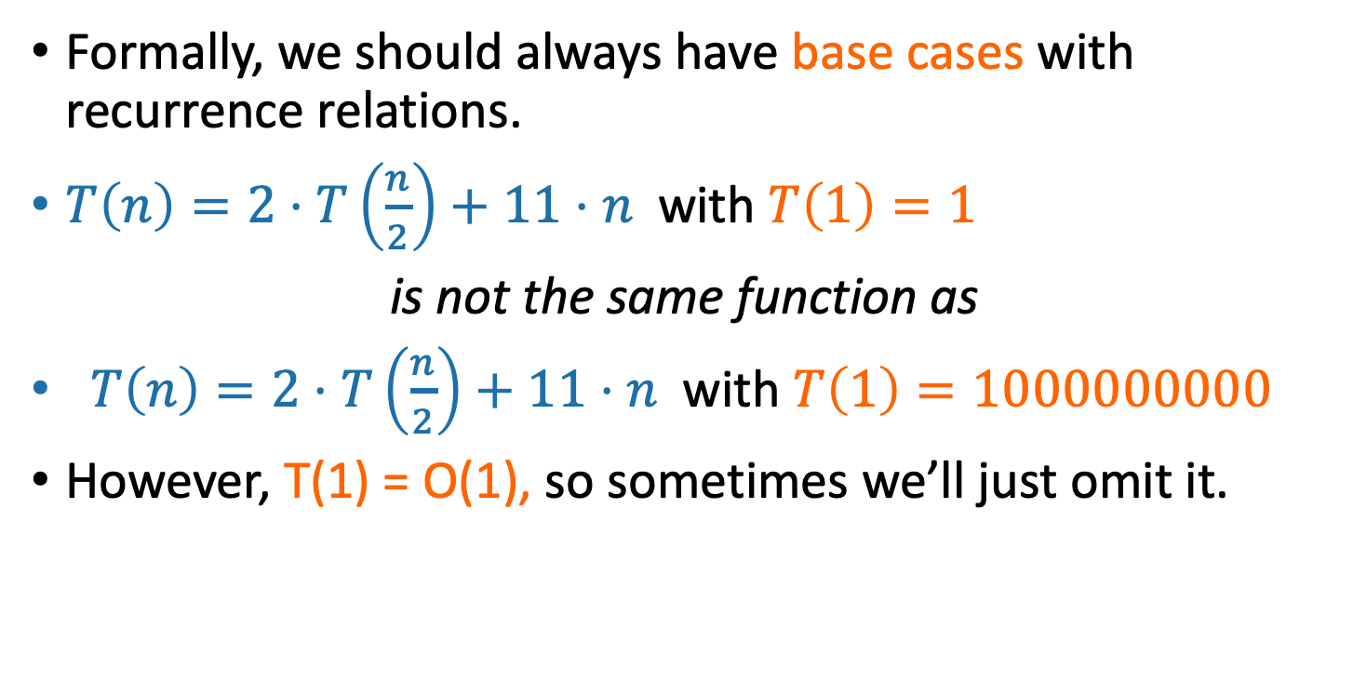
Technicalities I Base Cases
Plucky the Pedantic Penguin
Formally, we should always have base cases with recurrence relations.
$T\left(n\right)=2⋅T\left(\frac{n}{2}\right)+11⋅n$with $T\left(1\right)=1$
is not the same function as
$T\left(n\right)=2⋅T\left(\frac{n}{2}\right)+11⋅n$with $T\left(1\right)=1000000000$
However, T(1) = O(1), so sometimes we’ll just omit it.
Why does T(1) = O(1)?
Siggi the Studious Stork

Slide 11
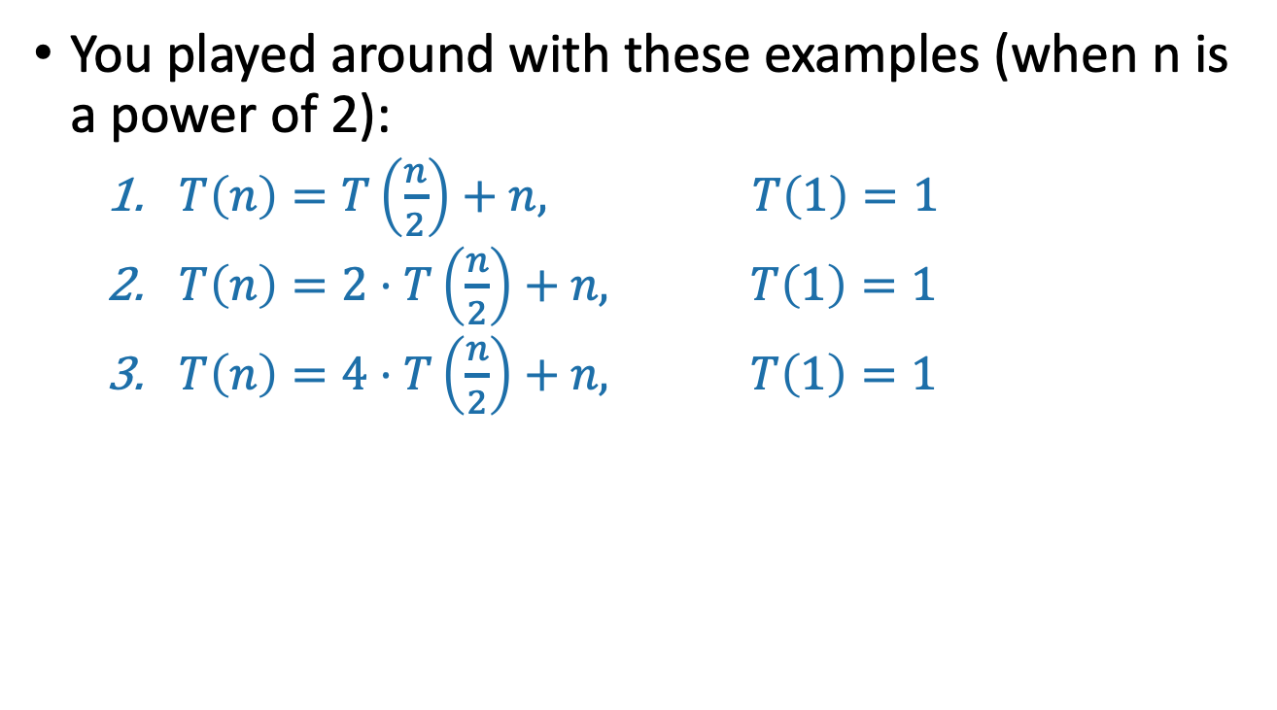
On your pre-lecture exercise
You played around with these examples (when n is a power of 2):
$T\left(n\right)=T\left(\frac{n}{2}\right)+n, T\left(1\right)=1$
$T\left(n\right)=2⋅T\left(\frac{n}{2}\right)+n, T\left(1\right)=1$
$T\left(n\right)=4⋅T\left(\frac{n}{2}\right)+n, T\left(1\right)=1$

Slide 12
One approach for all of these
Size n
The “tree” approach from last time.
Add up all the work done at all the sub-problems.
n/2
n/2
n/4
n/4
n/4
n/4
…
n/2^{t}
n/2^{t}
n/2^{t}
n/2^{t}
n/2^{t}
n/2^{t}
…
(Size 1)

Slide 13
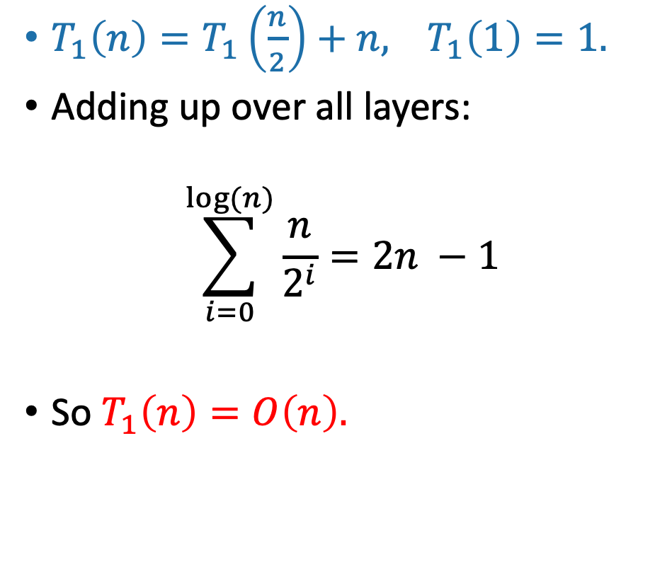
Solutions to pre-lecture exercise (1)
Contribution at this layer:
$T_{1}\left(n\right)=T_{1}\left(\frac{n}{2}\right)+n,$ $T_{1}\left(1\right)=1.$
Adding up over all layers:
$$\sum_{i=0}^{log⁡(n)}{\frac{n}{2^{i}}=2n −1}$$
So $T_{1}\left(n\right)=O\left(n\right).$
Size n
n
n/2
n/2
n/4
n/4
…
n/2^{t}
n/2^{t}
…
1
(Size 1)

Slide 14
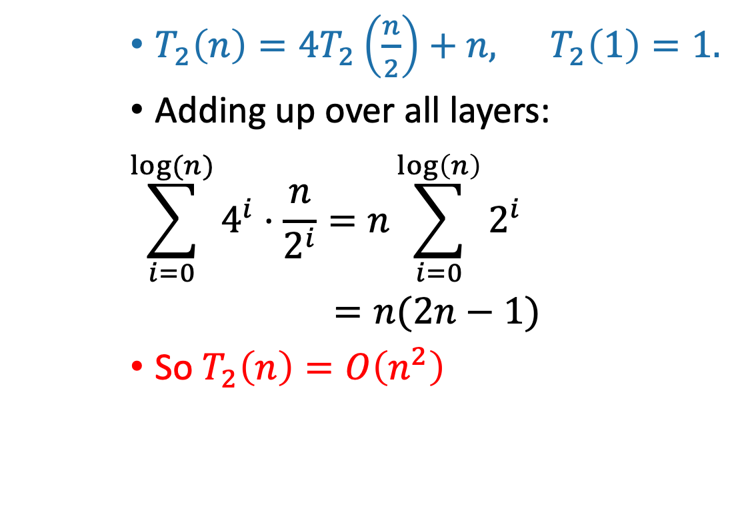
Solutions to pre-lecture exercise (2)
$T_{2}\left(n\right)={4T}_{2}\left(\frac{n}{2}\right)+n,$ $T_{2}\left(1\right)=1.$
Adding up over all layers:
$$\sum_{i=0}^{log⁡(n)}{4^{i}⋅\frac{n}{2^{i}}=n\sum_{i=0}^{\log\left(n\right)}{2^{i}}}$$
$=n(2n−1)$
So $T_{2}\left(n\right)=O\left(n^{2}\right)$
Contribution at this layer:
Size n
n
4x
n/2
2n
16x
n/4
4n
…
4^{t} x
n/2^{t}
2^{t}n
…
n² x
n²
(Size 1)

Slide 15
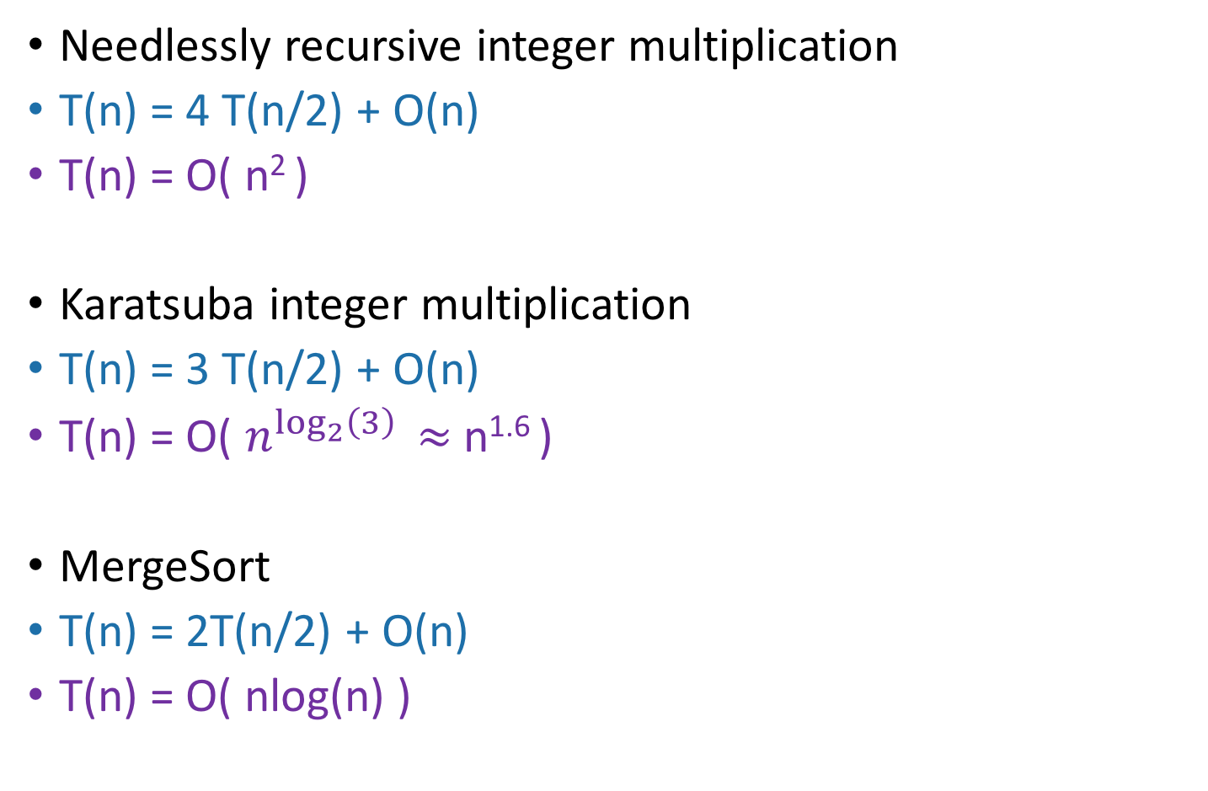
More examples
T(n) = time to solve a problem of size n.
Needlessly recursive integer multiplication
T(n) = 4 T(n/2) + O(n)
T(n) = O( n² )
Karatsuba integer multiplication
T(n) = 3 T(n/2) + O(n)
T(n) = O( $n^{\log_{2}\left(3\right)}$ $≈$ n^{1.6} )
MergeSort
T(n) = 2T(n/2) + O(n)
T(n) = O( nlog(n) )
This is similar to T₂ from the pre-lecture exercise.
What’s the pattern?!?!?!?!

Slide 16
The master theorem
A useful
formula it is.
Know why it works you should.
A formula for many recurrence relations.
We’ll see an example Wednesday when it won’t work.
Proof: “Generalized” tree method.
Jedi master Yoda

Slide 17
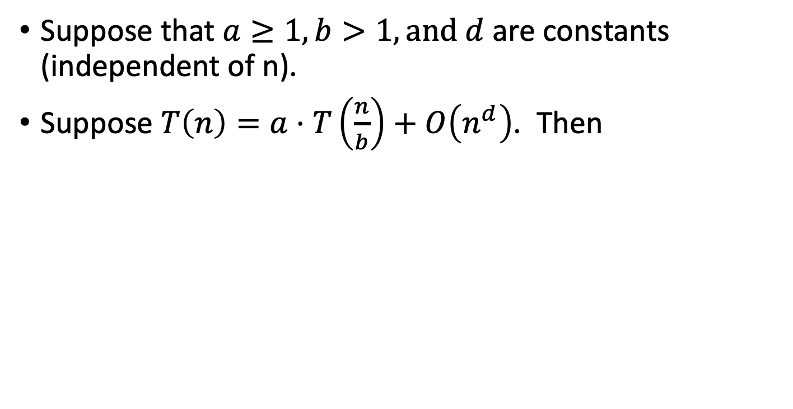
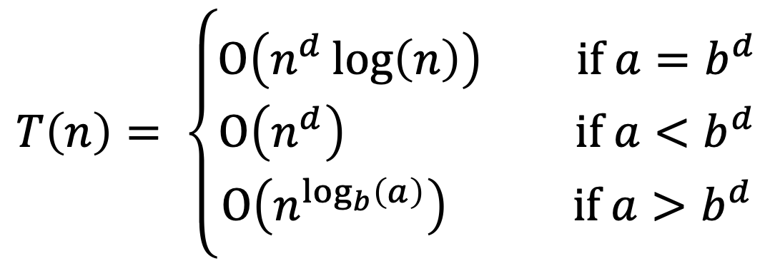
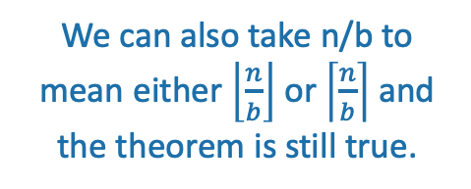
The master theorem
We can also take n/b to mean either $\left\lfloor \frac{n}{b}\right\rfloor$ or $\left\lceil \frac{n}{b}\right\rceil$ and the theorem is still true.
Suppose that $a≥1,b>1,and d$ are constants (independent of n).
Suppose $T\left(n\right)=a⋅T\left(\frac{n}{b}\right)+O\left(n^{d}\right)$. Then
$$T\left(n\right)= \left\{\begin{aligned}O\left(n^{d}\log\left(n\right)\right) if a=b^{d} \\ O\left(n^{d}\right) if a<b^{d} \\ O\left(n^{\log_{b}\left(a\right)}\right) if a>b^{d}\end{aligned}\right.$$
Three parameters:
a : number of subproblems
b : factor by which input size shrinks
d : need to do n^{d} work to create all the subproblems and combine their solutions.
Many symbols those are….

Slide 18
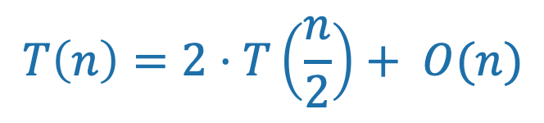
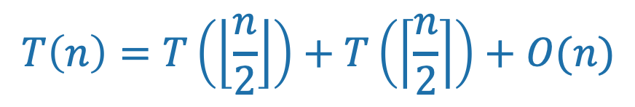
Technicalities II Integer division
Plucky the Pedantic Penguin
If n is odd, I can’t break it up into two problems of size n/2.
However (see CLRS, Section 4.6.2), one can show that the Master theorem works fine if you pretend that what you have is:
Read CLRS 4.6.2; and from now on we’ll mostly ignore floors and ceilings in recurrence relations.
$$T\left(n\right)=T\left(\left\lfloor \frac{n}{2}\right\rfloor \right)+T\left(\left\lceil \frac{n}{2}\right\rceil \right)+O(n)$$
$$T\left(n\right)=2⋅T\left(\frac{n}{2}\right)+ O(n)$$

Slide 19
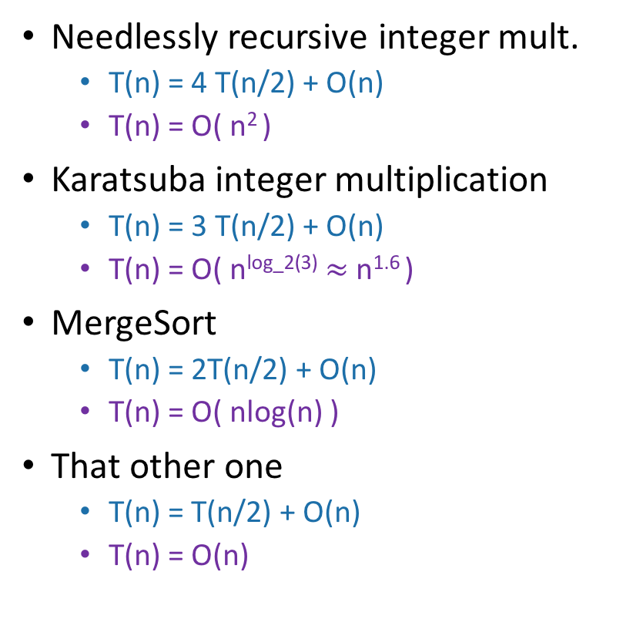
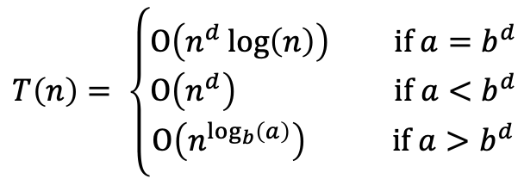
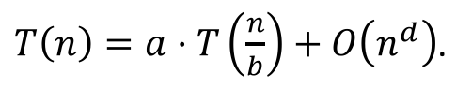
Examples (details on board)
$T\left(n\right)=a⋅T\left(\frac{n}{b}\right)+O\left(n^{d}\right)$.
$$T\left(n\right)= \left\{\begin{aligned}O\left(n^{d}\log\left(n\right)\right) if a=b^{d} \\ O\left(n^{d}\right) if a<b^{d} \\ O\left(n^{\log_{b}\left(a\right)}\right) if a>b^{d}\end{aligned}\right.$$
Needlessly recursive integer mult.
T(n) = 4 T(n/2) + O(n)
T(n) = O( n² )
Karatsuba integer multiplication
T(n) = 3 T(n/2) + O(n)
T(n) = O( n^{log_2(3)} $≈$ n^{1.6} )
MergeSort
T(n) = 2T(n/2) + O(n)
T(n) = O( nlog(n) )
That other one
T(n) = T(n/2) + O(n)
T(n) = O(n)
✓
a = 4
b = 2
d = 1
a > b^{d}
✓
a = 3
b = 2
d = 1
a > b^{d}
✓
a = 2
b = 2
d = 1
a = b^{d}
✓
a = 1
b = 2
d = 1
a < b^{d}

Slide 20
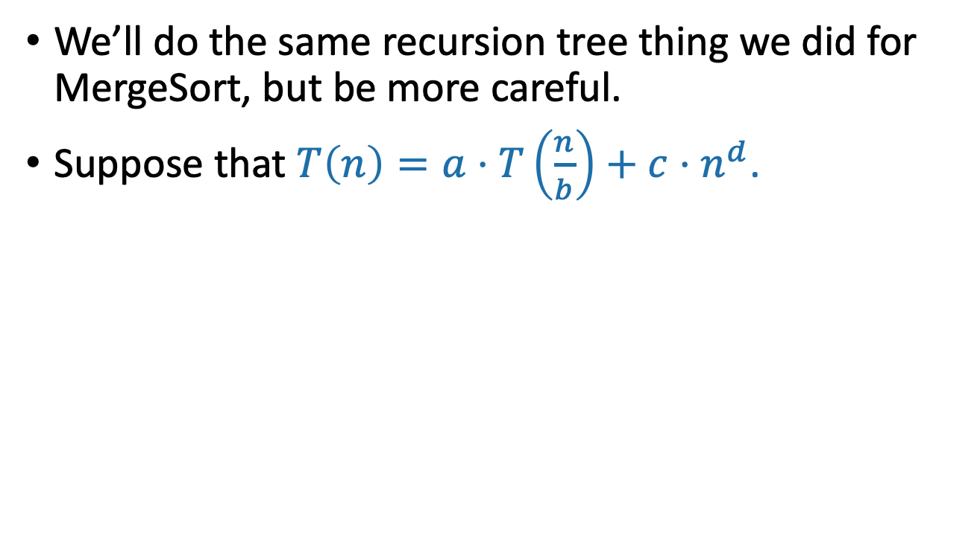
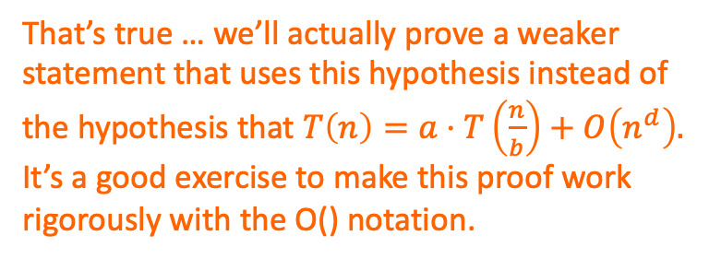
Proof of the master theorem
We’ll do the same recursion tree thing we did for MergeSort, but be more careful.
Suppose that $T\left(n\right)=a⋅T\left(\frac{n}{b}\right)+c⋅n^{d}$.
Hang on! The hypothesis of the Master Theorem was the the extra work at each level was O(n^{d}). That’s NOT the same as work <= cn^{d} for some constant c.
That’s true … we’ll actually prove a weaker statement that uses this hypothesis instead of the hypothesis that $T\left(n\right)=a⋅T\left(\frac{n}{b}\right)+O\left(n^{d}\right).$ It’s a good exercise to make this proof work rigorously with the O() notation.
Plucky the
Pedantic Penguin
Siggi the Studious Stork

Slide 21
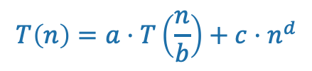
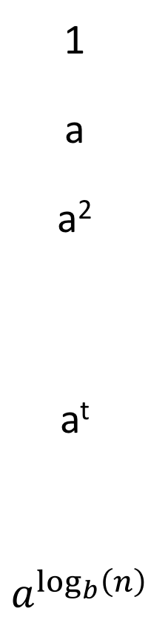
Recursion tree
$$T\left(n\right)=a⋅T\left(\frac{n}{b}\right)+c{⋅n}^{d}$$
Amount of work at this level
Size of each
problem
#
problems
Level
Size n
0
1
a
a²
a^{t}
$$a^{\log_{b}\left(n\right)}$$
n
n/b
n/b²
n/b^{t}
1
n/b
n/b
n/b
1
n/b²
n/b²
n/b²
n/b²
2
n/b²
n/b²
n/b²
…
n/b^{t}
n/b^{t}
n/b^{t}
n/b^{t}
n/b^{t}
n/b^{t}
t
…
…
log_{b}(n)
(Size 1)

Slide 22
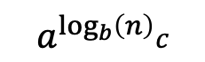
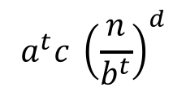
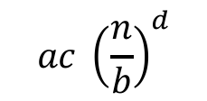
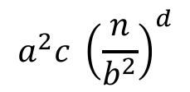
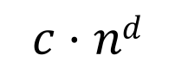
Recursion tree
$$T\left(n\right)=a⋅T\left(\frac{n}{b}\right)+c{⋅n}^{d}$$
Amount of work at this level
Size of each
problem
Help me fill this in!
#
problems
Level
Size n
$$c⋅nd$$
0
1
a
a²
a^{t}
$$a^{\log_{b}\left(n\right)}$$
n
n/b
n/b²
n/b^{t}
1
$$ac {\left(\frac{n}{b}\right)}^{d}$$
n/b
n/b
n/b
1
n/b²
n/b²
n/b²
$$a^{2}c {\left(\frac{n}{b^{2}}\right)}^{d}$$
n/b²
2
n/b²
n/b²
n/b²
…
n/b^{t}
n/b^{t}
n/b^{t}
n/b^{t}
n/b^{t}
n/b^{t}
t
$$a^{t}c {\left(\frac{n}{b^{t}}\right)}^{d}$$
…
…
log_{b}(n)
$$a^{\log_{b}\left(n\right)}c$$
(Let’s pretend that the base case isT(1) = c for convenience).
(Size 1)

Slide 23
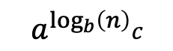
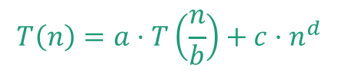
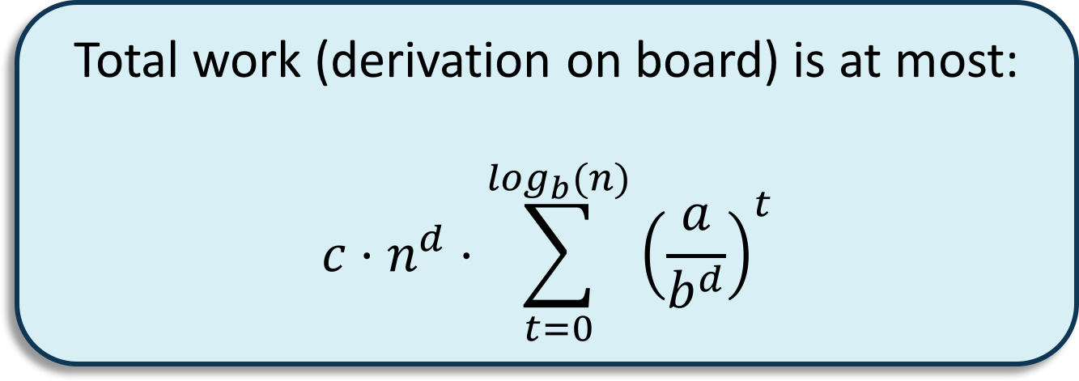
Recursion tree
$$T\left(n\right)=a⋅T\left(\frac{n}{b}\right)+c{⋅n}^{d}$$
Amount of work at this level
Size of each
problem
#
problems
Level
Size n
$$c⋅nd$$
0
1
a
a²
a^{t}
$$a^{\log_{b}\left(n\right)}$$
n
n/b
n/b²
n/b^{t}
1
$$ac {\left(\frac{n}{b}\right)}^{d}$$
n/b
n/b
n/b
1
Total work (derivation on board) is at most:
$$c⋅n^{d}⋅\sum_{t=0}^{\log_{b}(n)}{{\left(\frac{a}{b^{d}}\right)}^{t}}$$
n/b²
n/b²
n/b²
$$a^{2}c {\left(\frac{n}{b^{2}}\right)}^{d}$$
n/b²
2
n/b²
n/b²
n/b²
…
n/b^{t}
n/b^{t}
n/b^{t}
n/b^{t}
n/b^{t}
n/b^{t}
t
$$a^{t}c {\left(\frac{n}{b^{t}}\right)}^{d}$$
…
…
log_{b}(n)
$$a^{\log_{b}\left(n\right)}c$$
(Let’s pretend that the base case isT(1) = c for convenience).
(Size 1)

Slide 24
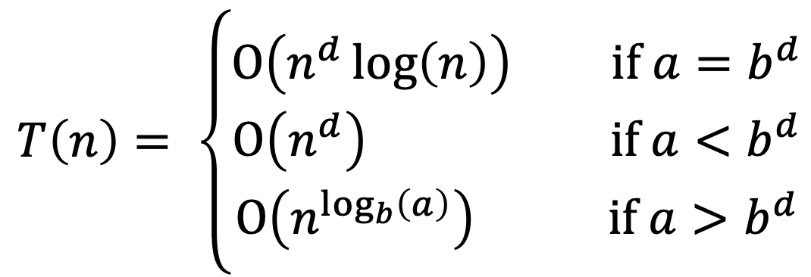
Now let’s check all the cases
$$T\left(n\right)= \left\{\begin{aligned}O\left(n^{d}\log\left(n\right)\right) if a=b^{d} \\ O\left(n^{d}\right) if a<b^{d} \\ O\left(n^{\log_{b}\left(a\right)}\right) if a>b^{d}\end{aligned}\right.$$
Do the first one!

Slide 25
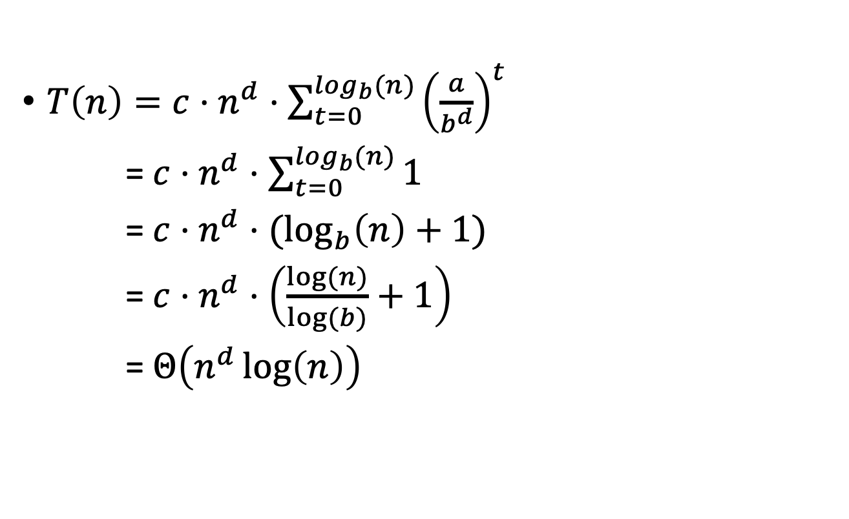
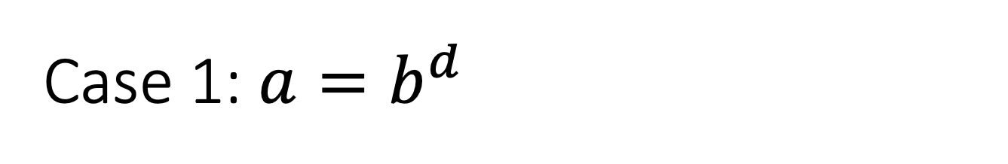
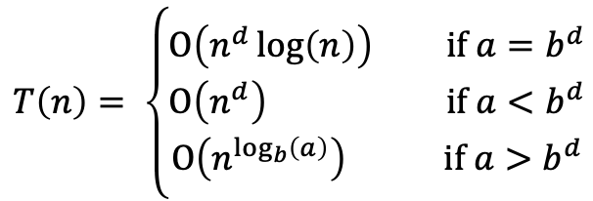
Case 1: $a=b^{d}$
$$T\left(n\right)= \left\{\begin{aligned}O\left(n^{d}\log\left(n\right)\right) if a=b^{d} \\ O\left(n^{d}\right) if a<b^{d} \\ O\left(n^{\log_{b}\left(a\right)}\right) if a>b^{d}\end{aligned}\right.$$
$T\left(n\right)=c⋅n^{d}⋅\sum_{t=0}^{\log_{b}(n)}{{\left(\frac{a}{b^{d}}\right)}^{t}}$
= $c⋅n^{d}⋅\sum_{t=0}^{\log_{b}(n)}{1}$
= $c⋅n^{d}⋅(\log_{b}\left(n\right)+1)$
= $c⋅n^{d}⋅\left(\frac{log⁡(n)}{log⁡(b)}+1\right)$
= $Θ\left(n^{d}\log\left(n\right)\right)$

Slide 26
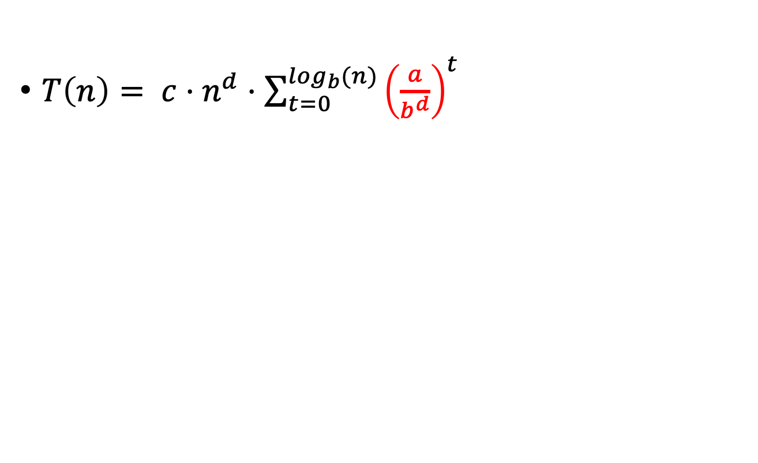
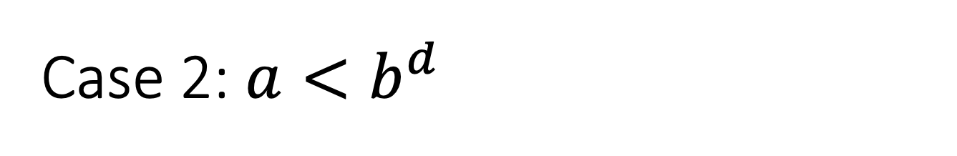
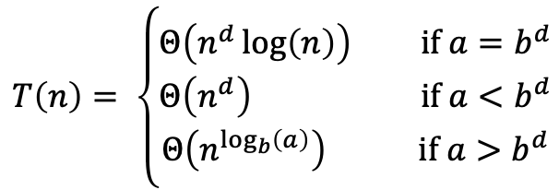
Case 2: $a<b^{d}$
$$T\left(n\right)= \left\{\begin{aligned}Θ\left(n^{d}\log\left(n\right)\right) if a=b^{d} \\ Θ\left(n^{d}\right) if a<b^{d} \\ Θ\left(n^{\log_{b}\left(a\right)}\right) if a>b^{d}\end{aligned}\right.$$
$T\left(n\right)= c⋅n^{d}⋅\sum_{t=0}^{\log_{b}(n)}{{\left(\frac{a}{b^{d}}\right)}^{t}}$
Less than 1!

Slide 27
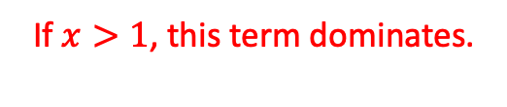
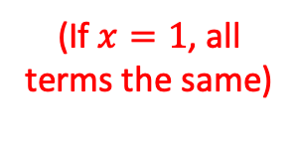
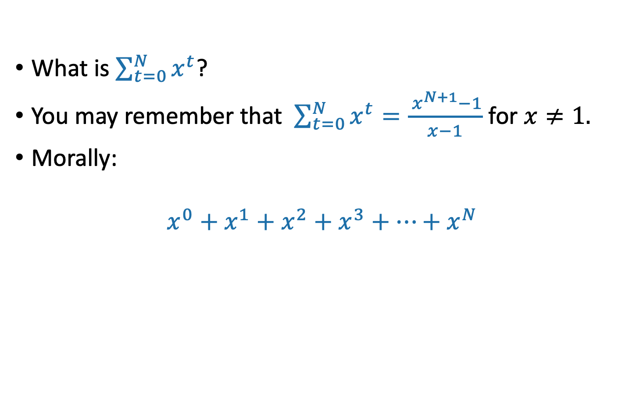
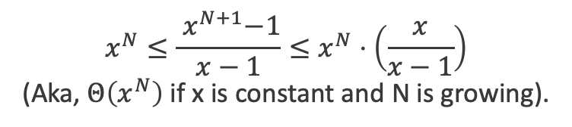

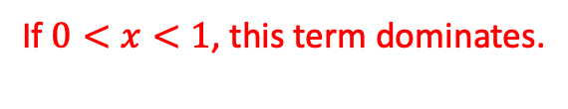
Aside: Geometric sums
What is $\sum_{t=0}^{N}{x^{t}}$?
You may remember that $\sum_{t=0}^{N}{x^{t}}=\frac{{ x}^{N+1}−1}{x−1}$ for $x≠1.$
Morally:
$$x^{0}+x^{1}+x^{2}+x^{3}+⋯+x^{N}$$
If $0<x<1$, this term dominates.
(If $x=1$, all terms the same)
If $x>1$, this term dominates.
$$1≤\frac{{ 1−x}^{N+1}}{1−x}≤\frac{1}{1−x}$$
(Aka, doesn’t depend on N).
$$x^{N}≤\frac{{ x}^{N+1}−1}{x−1}≤x^{N}⋅\left(\frac{x}{x−1}\right)$$
(Aka, $Θ\left(x^{N}\right)$ if x is constant and N is growing).

Slide 28
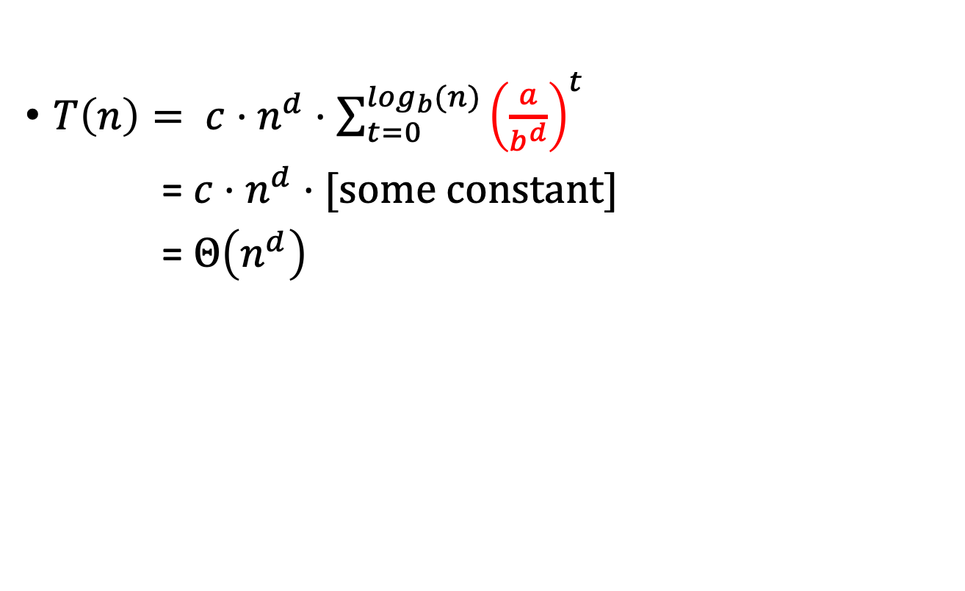
Case 2: $a<b^{d}$
$$T\left(n\right)= \left\{\begin{aligned}O\left(n^{d}\log\left(n\right)\right) if a=b^{d} \\ O\left(n^{d}\right) if a<b^{d} \\ O\left(n^{\log_{b}\left(a\right)}\right) if a>b^{d}\end{aligned}\right.$$
$T\left(n\right)= c⋅n^{d}⋅\sum_{t=0}^{\log_{b}(n)}{{\left(\frac{a}{b^{d}}\right)}^{t}}$
= $c⋅n^{d}⋅[some constant]$
= $Θ\left(n^{d}\right)$
Less than 1!

Slide 29

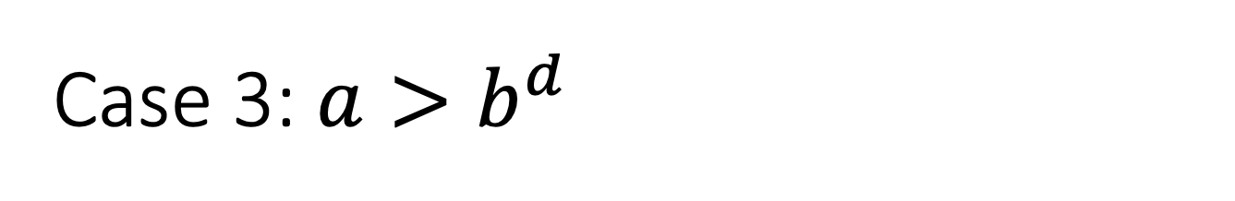
Case 3: $a>b^{d}$
$$T\left(n\right)= \left\{\begin{aligned}O\left(n^{d}\log\left(n\right)\right) if a=b^{d} \\ O\left(n^{d}\right) if a<b^{d} \\ O\left(n^{\log_{b}\left(a\right)}\right) if a>b^{d}\end{aligned}\right.$$
$T\left(n\right)= c⋅n^{d}⋅\sum_{t=0}^{\log_{b}{(n)}}{{\left(\frac{a}{b^{d}}\right)}^{t}}$
= $Θ\left(n^{d}{\left(\frac{a}{b^{d}}\right)}^{\log_{b}{(n)}}\right)$
=$Θ\left(n^{\log_{b}{(a)}}\right)$
Larger than 1!
Convice yourself that this step is legit!
We’ll do this step on the board!

Slide 30
Now let’s check all the cases
$$T\left(n\right)= \left\{\begin{aligned}O\left(n^{d}\log\left(n\right)\right) if a=b^{d} \\ O\left(n^{d}\right) if a<b^{d} \\ O\left(n^{\log_{b}\left(a\right)}\right) if a>b^{d}\end{aligned}\right.$$

Slide 31
Even more generally, for T(n) = aT(n/b) + f(n)…
Figure out how to adapt the proof we gave to prove this more general version!
[From CLRS]
Ollie the Over-Achieving Ostrich

Slide 32
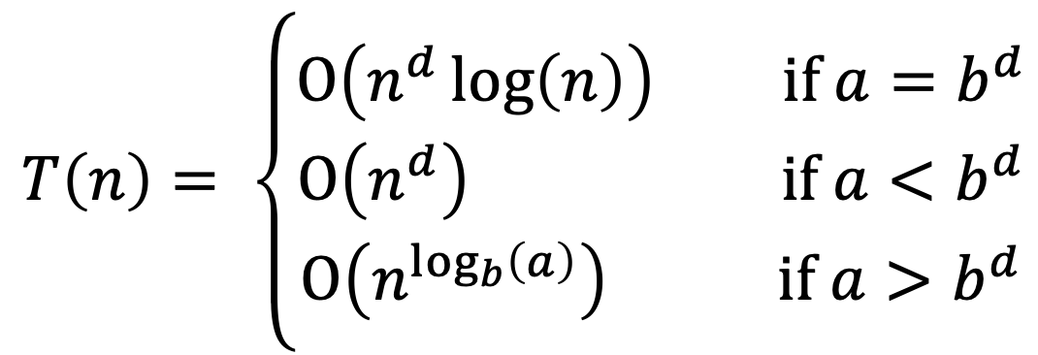
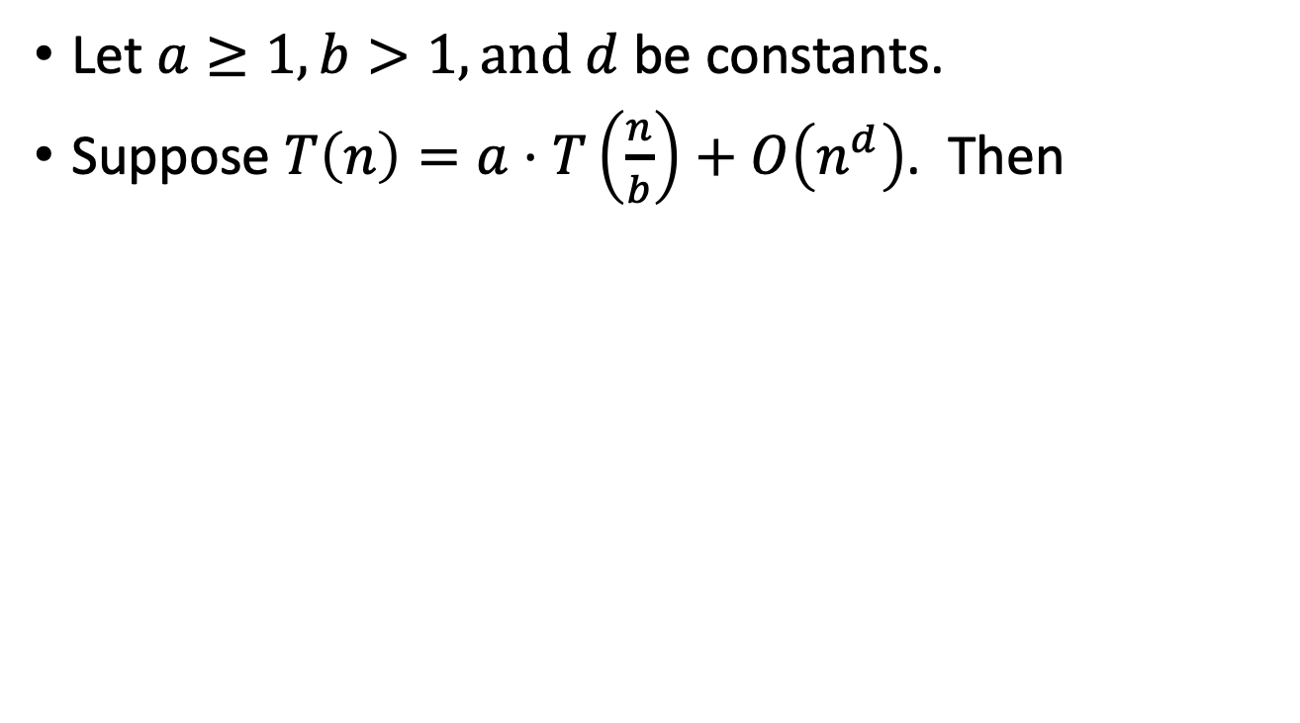
Understanding the Master Theorem
Let $a≥1,b>1,and d$ be constants.
Suppose $T\left(n\right)=a⋅T\left(\frac{n}{b}\right)+O\left(n^{d}\right)$. Then
$$T\left(n\right)= \left\{\begin{aligned}O\left(n^{d}\log\left(n\right)\right) if a=b^{d} \\ O\left(n^{d}\right) if a<b^{d} \\ O\left(n^{\log_{b}\left(a\right)}\right) if a>b^{d}\end{aligned}\right.$$
What do these three cases mean?

Slide 33
The eternal struggle
Branching causes the number of problems to explode!
The most work is at the bottom of the tree!
The problems lower in the tree are smaller! The most work is at the top of the tree!

Slide 34
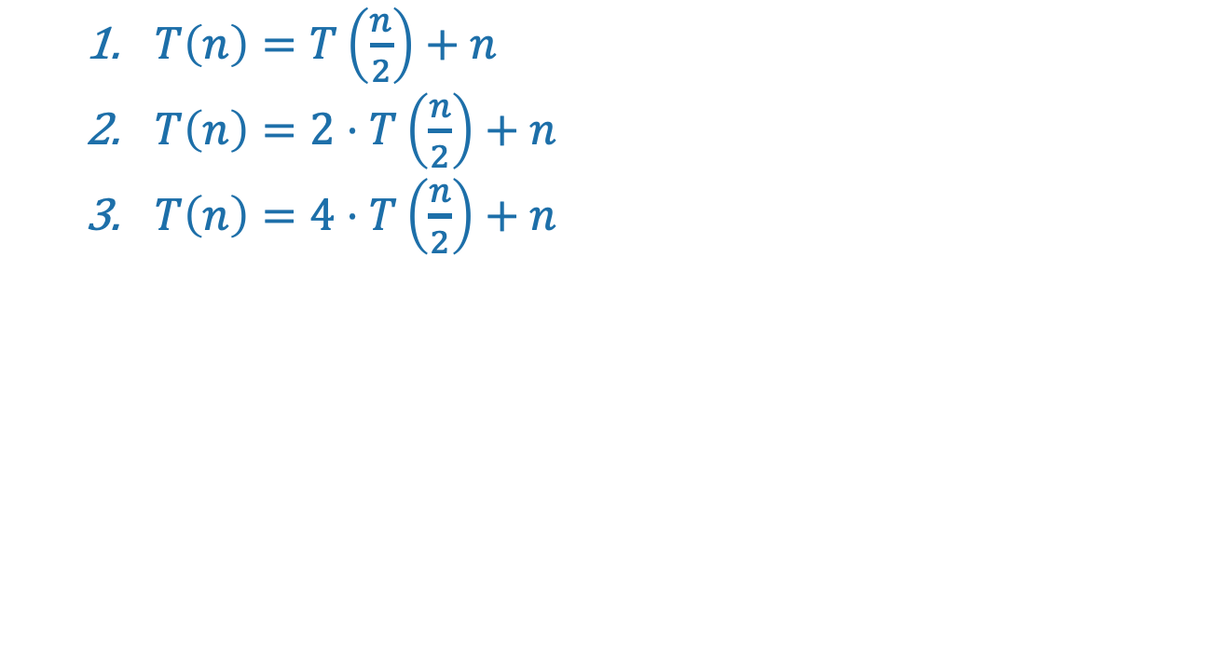
Consider our three warm-ups
$T\left(n\right)=T\left(\frac{n}{2}\right)+n$
$T\left(n\right)=2⋅T\left(\frac{n}{2}\right)+n$
$T\left(n\right)=4⋅T\left(\frac{n}{2}\right)+n$

Slide 35
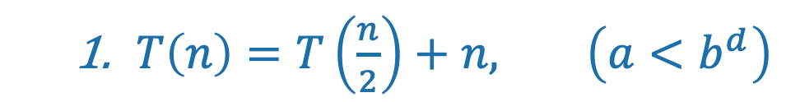
First example: tall and skinny tree
$T\left(n\right)=T\left(\frac{n}{2}\right)+n, \left(a<b^{d}\right)$
Size n
The amount of work done at the top (the biggest problem) swamps the amount of work done anywhere else.
T(n) = O( work at top ) = O(n)
n/2
n/4
n/2^{t}
WINNER
Most work at the top of the tree!
1

Slide 36
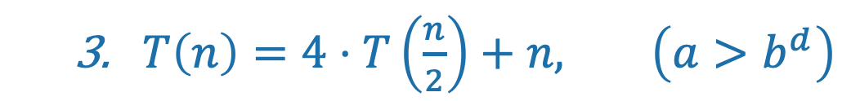
Third example: bushy tree
WINNER
$T\left(n\right)=4⋅T\left(\frac{n}{2}\right)+n, \left(a>b^{d}\right)$
Size n
Most work at the bottom of the tree!
n/2
n/2
n/2
n/2
There are a HUGE number of leaves, and the total work is dominated by the time to do work at these leaves.
T(n) = O( work at bottom ) = O( 4^{depth of tree} ) = O(n²)
1
1
1
1
1
1
1
1
1
1
1
1
1
1
1
1
1
1
1
1
1
1
1
1
1
1
1
1
1
1
1
1
1
1
1
1
1
1
1
1
1
1
1
1
1
1
1
1
1
1
1
1
1
1
1
1
1
1
1
1
1
1
1

Slide 37
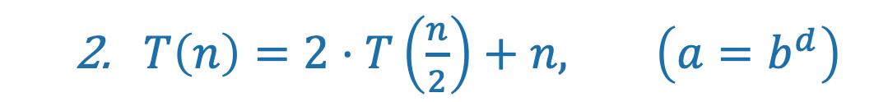
Second example: just right
$T\left(n\right)=2⋅T\left(\frac{n}{2}\right)+n, \left(a=b^{d}\right)$
Size n
The branching just balances out the amount of work.
n/2
n/2
The same amount of work is done at every level.
n/4
n/4
n/4
n/4
T(n) = (number of levels) * (work per level)
= log(n) * O(n) = O(nlog(n))
TIE!
1
1
1
1
1
1
1
1
1
1

Slide 38
What have we learned?
The “Master Method” makes our lives easier.
But it’s basically just codifying a calculation we could do from scratch if we wanted to.

Slide 39
The Substitution Method
Another way to solve recurrence relations.
More general than the master method.
Step 1: Generate a guess at the correct answer.
Step 2: Try to prove that your guess is correct.
(Step 3: Profit.)

Slide 40

The Substitution Method first example
Let’s return to:
$T\left(n\right)=2⋅T\left(\frac{n}{2}\right)+n$, with $T\left(0\right)=0, T\left(1\right)=1.$
The Master Method says $T\left(n\right)=O\left(n\log\left(n\right)\right)$.
We will prove this via the Substitution Method.

Slide 41





Step 1: Guess the answer
$T\left(n\right)=2⋅T\left(\frac{n}{2}\right)+n$, with $T\left(1\right)=1.$
You can guess the answer however you want: meta-reasoning, a little bird told you, wishful thinking, etc. One useful way is to try to “unroll” the recursion, like we’re doing here.
$T\left(n\right)=2⋅T\left(\frac{n}{2}\right)+n$
$T\left(n\right)=2⋅\left(2⋅T\left(\frac{n}{4}\right)+\frac{n}{2}\right)+n$
$T\left(n\right)=4⋅T\left(\frac{n}{4}\right)+2n$
$T\left(n\right)=4⋅\left(2⋅T\left(\frac{n}{8}\right)+\frac{n}{4}\right)+2n$
$T\left(n\right)=8⋅T\left(\frac{n}{8}\right)+3n$
…
Expand $T\left(\frac{n}{2}\right)$
Simplify
Expand $T\left(\frac{n}{4}\right)$
Simplify
Guessing the pattern: $T\left(n\right)=2^{t}⋅T\left(\frac{n}{2^{t}}\right)+t⋅n$
Plug in $t=\log\left(n\right),$ and get
$$T\left(n\right)=n⋅T\left(1\right)+\log\left(n\right)⋅n=n\left(\log\left(n\right)+1\right)$$

Slide 42

Step 2: Prove the guess is correct.
$T\left(n\right)=2⋅T\left(\frac{n}{2}\right)+n$, with $T\left(1\right)=1.$
Inductive Hyp. (n): $T\left(j\right)=j\left(\log\left(j\right)+1\right)$ for all $1≤j≤n$.
Base Case (n=1): $T\left(1\right)=1=1⋅\left(\log\left(1\right)+1\right)$
Inductive Step:
Assume Inductive Hyp. for n=k-1:
Suppose that $T\left(j\right)=j\left(\log\left(j\right)+1\right)$ for all $1≤j≤k−1.$
$T\left(k\right)=2⋅T\left(\frac{k}{2}\right)+k$ by definition
$T\left(k\right)=2⋅\left(\frac{k}{2}\left(\log\left(\frac{k}{2}\right)+1\right)\right)+k$ by induction.
$T\left(k\right)=k\left(\log\left(k\right)+1\right)$ by simplifying.
So Inductive Hyp. holds for n=k.
Conclusion: For all $n≥1,$ $T\left(n\right)=n\left(\log\left(n\right)+1\right)$
We just replaced the “n” in the statement of the inductive hypothesis with an ”k-1” to get the I.H. for k-1.
We’re being sloppy here about floors and ceilings…what would you need to do to be less sloppy?

Slide 43

Step 3: Profit
Pretend like you never did Step 1, and just write down:
Theorem: $T\left(n\right)=O(n\log\left(n\right))$
Proof: [Whatever you wrote in Step 2]

Slide 44
What have we learned?
The substitution method is a different way of solving recurrence relations.
Step 1: Guess the answer.
Step 2: Prove your guess is correct.
Step 3: Profit.
We’ll get more practice with the substitution method next lecture!

Slide 45

Another example (if time)
(If not time, that’s okay; we’ll see these ideas in Lecture 4)
$T\left(n\right)=2⋅T\left(\frac{n}{2}\right)+32⋅n$
$T\left(2\right)=2$
Step 1: Guess: $O(n\log\left(n\right))$ (divine inspiration).
But I don’t have such a precise guess about the form for the $O(n log⁡(n))$ …
That is, what’s the leading constant?
Can I still do Step 2?

Slide 46


Step 2: Prove it, working backwards to figure out the constant
Guess: $T\left(n\right)≤C⋅n\log\left(n\right)$ for some constant C TBD.
Inductive Hypothesis: $T\left(j\right)≤C⋅j\log\left(j\right)$ for $2≤j≤n$
Base case: $T\left(2\right)=2≤C⋅2\log\left(2\right)$ as long as $C≥1$
Inductive Step:
$$T\left(n\right)=2⋅T\left(\frac{n}{2}\right)+32⋅n$$
$$T\left(2\right)=2$$

Slide 47

Inductive step
Inductive Hypothesis: $T\left(j\right)≤C⋅j\log\left(j\right)$ for $2≤j≤n$
Assume that the inductive hypothesis holds for n=k-1.
$T\left(k\right)=2T\left(\frac{k}{2}\right)+32k$
$≤2C\frac{k}{2}log\left(\frac{k}{2}\right)+32k$
$=k\left(C⋅\log\left(k\right)+32 −C\right)$
$≤k\left(C⋅\log{(k)}\right)$ as long as $C≥32$.
Then the inductive hypothesis holds for n=k.
$$T\left(n\right)=2⋅T\left(\frac{n}{2}\right)+32⋅n$$
$$T\left(2\right)=2$$

Slide 48

Step 2: Prove it, working backwards to figure out the constant
Guess: $T\left(n\right)≤C⋅n\log\left(n\right)$ for some constant C TBD.
Inductive Hypothesis: $T\left(j\right)≤C⋅j\log\left(j\right)$ for $2≤j≤n$
Base case: $T\left(2\right)=2≤C⋅2\log\left(2\right)$ as long as $C≥1$
Inductive step: Works as long as $C≥32$
So choose $C=32$.
Conclusion: $T\left(n\right)≤32⋅n\log\left(n\right)$
$$T\left(n\right)=2⋅T\left(\frac{n}{2}\right)+32⋅n$$
$$T\left(2\right)=2$$

Slide 49

Step 3: Profit.
Theorem: $T\left(n\right)=O(n\log\left(n\right))$
Proof:
Inductive Hypothesis: $T\left(j\right)≤32⋅j\log\left(j\right)$ for $2≤j≤n$
Base case: $T\left(2\right)=2≤32⋅2\log\left(2\right)$ is true.
Inductive step:
Assume Inductive Hyp. for n=k-1.
$T(k)=2T\left(\frac{k}{2}\right)+32k$
$≤2⋅32⋅\frac{k}{2}log\left(\frac{k}{2}\right)+32k$
$=k\left(32⋅\log\left(k\right)+32 −32\right)$
$=32⋅k log⁡(k)$
This establishes inductive hyp. for n=k.
Conclusion: $T\left(n\right)≤32⋅n\log\left(n\right)$ for all $n≥2$.
By the def. of T(k)
By induction

Slide 50

Aside: The form of the inductive hypothesis
This slide added after lecture
In the previous examples, we had an inductive hypothesis of the form:
$T\left(j\right)≤32⋅j\log\left(j\right)$ for $2≤j≤n$
The reason it was written like that is because that’s what it should be if I’m doing “standard” induction. That is, the inductive step is: assuming that the inductive hypothesis holds for k-1, show that it holds for k.
However, if one uses strong induction, it’s fine to use an inductive hypothesis of the form:
$$T\left(n\right)≤32⋅n\log\left(n\right)$$
In this case, the inductive step would be: assuming that the inductive hypothesis holds for all $2≤j<k$, show that it holds for k.
Both ways are totally fine.

Slide 51
Why two methods?
Sometimes the Substitution Method works where the Master Method does not.
More on this next time!

Slide 52
Next Time
What happens if the sub-problems are different sizes?
And when might that happen?
BEFORE Next Time
Pre-Lecture Exercise 4!

